Slide 1
Using of fruits and vegetables as home medicine.
Diner Alina
Form 6

Slide 2
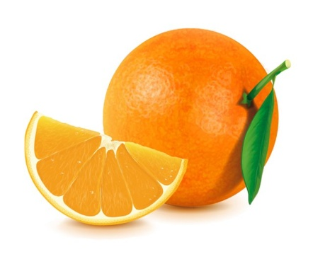
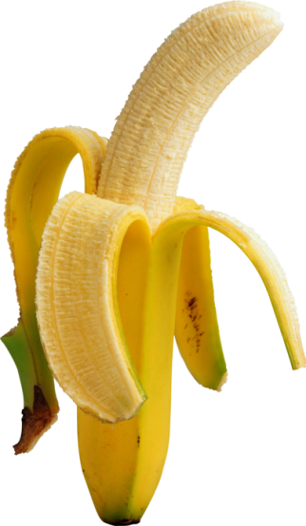
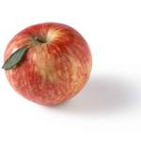
To be healthy we should eat a lot of fruit and vegetables.

Slide 3
Lemon
Helps to fight infection.It is very useful for healthy bones and teeth.It has vitamin C.

Slide 4
Strengthen our eyes.They help us grow.They are useful for skin and hair.They have vitamin A.
Tomatoes

Slide 5
Cabbage
Helps to fight infection. It is very good for healthy bones and teeth. It has vitamin C.

Slide 6
Pumpkin
Strengthen our eyes.They help us grow.They are useful for skin and hair.They have vitamin A.

Slide 7
Proverbs:
Health above wealth
Apple for dinner-and the doctor does not need
If you want to live two hundred years-eat greens for lunch
An apple a day keeps the doctor a way

